Slide 1

Litecoin and Chainlink Cryptocurrency vs APPL and TSLA Stock

Slide 2



We are going to analyze cryptocurrency and stock by seperating into 3 sections.
1. Litecoin and Chainlink Portfolio - data from API
2. Apple and Tesla Portfolio - data from new library Yahoo Finance
3. Cryptocurrency and stock combined portfolio

Slide 3
We add new library Yahoo Finance import yfinance as yf
For section 1 cryptocurrency, we analyzed Litecoin and Chainlink daily closed price for 5 years from 2017 to 2022 with below concept. From the output we get, we can summarize the general performace for each cryptocurrency and make a comparison.
For section 2 stock, we analyzed Apple and Tesla stock performance by using Morte Carlo Stimulation to forcast 3 years performance.
For section 3, we combined cryptocurrency and stock to one portfolio. From there, we can see the investment outcomes according to our weights.

Slide 4
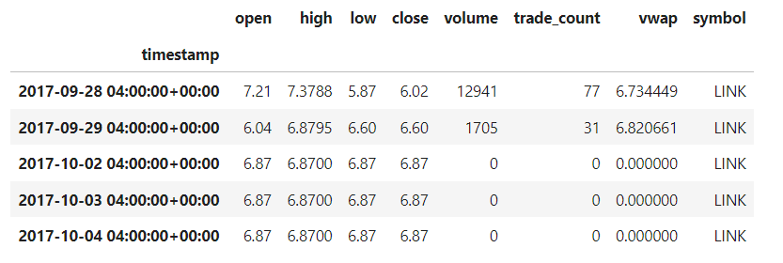
Part 1 - Litecoin and Chainlink Cryptocurrency Analysis
Data frame for Litecoin and Chainlink

Slide 5
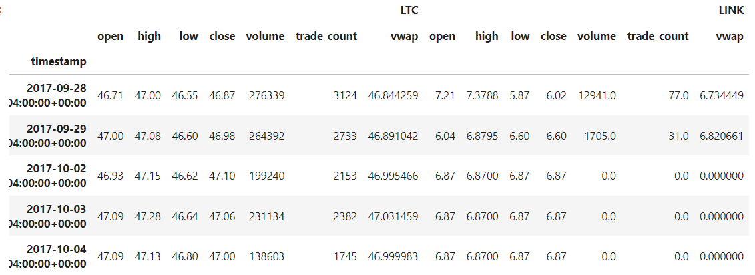
Combine Litecoin and Chainlink

Slide 6
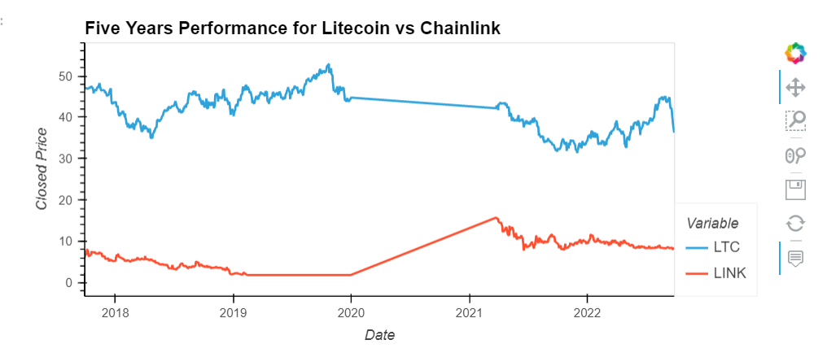
Create line graph to show Litecoin and Chainlink closed price performance

Slide 7
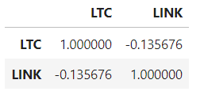
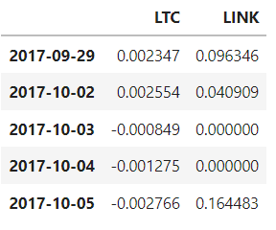
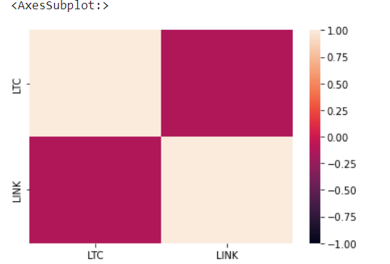
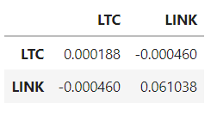
The daily return, covariance/variance, standard deviation and correlation.
Covariance
Daily Return
Correlation
Variance

Slide 8
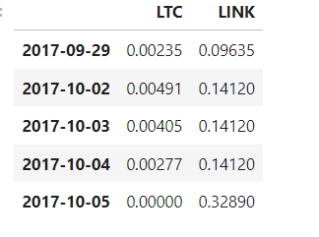
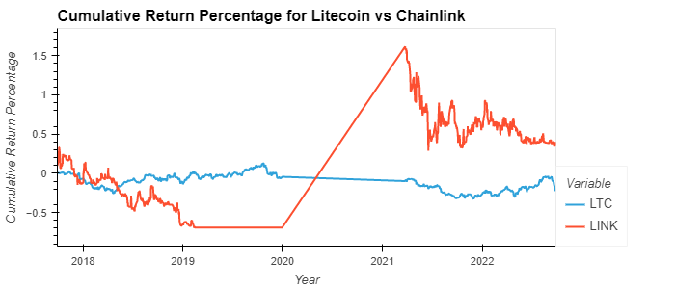
Cumulative Returns

Slide 9
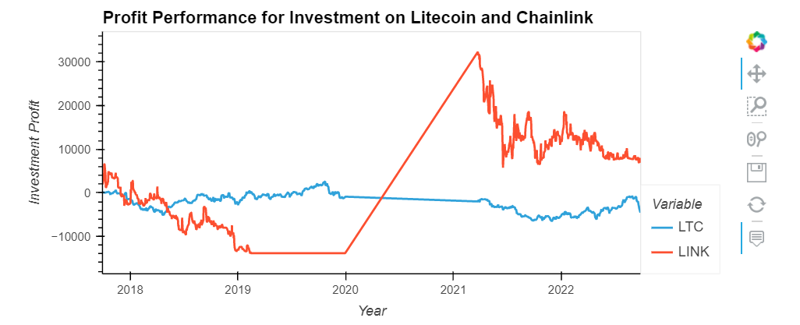
Investment performance on cryptocurrency
Initial Investment $20,000

Slide 10
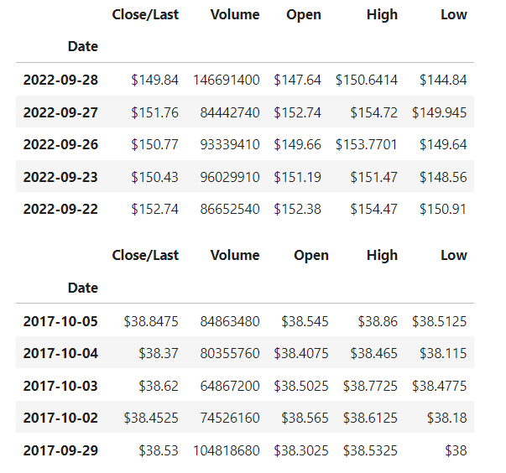
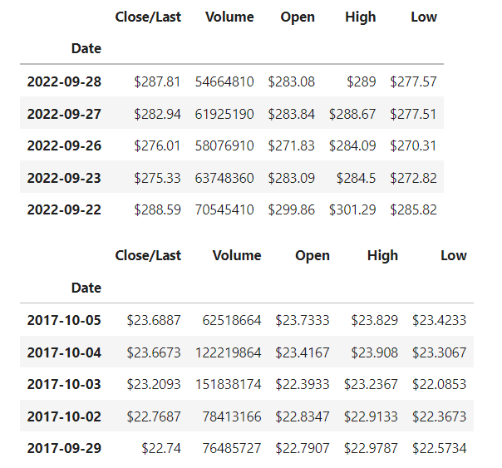
Part 2 - Apple and Tesla Stock Analysis
APPLE
TESLA

Slide 11
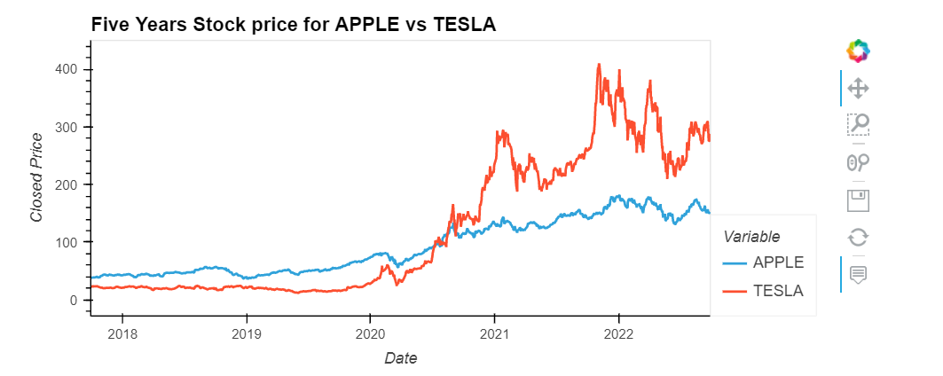
Five Year Stock Permance – Apple vs Tesla

Slide 12
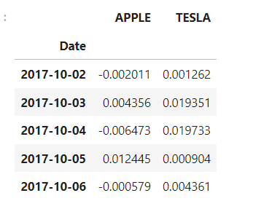

Daily return for Apple and Tesla Standard deviation of daily return for Apple and Tesla
Daily Return
Standard Deviation

Slide 13
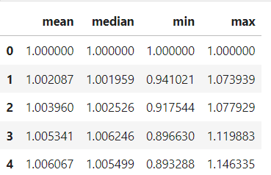
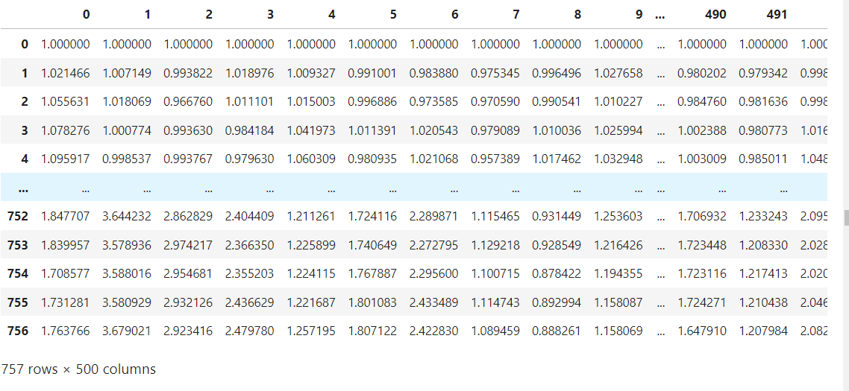
2.5 Monte Carlo simulation on Apple

Slide 14
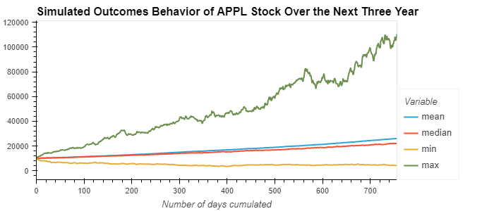
Create a line graph to forcast Profit performance for Apple

Slide 15
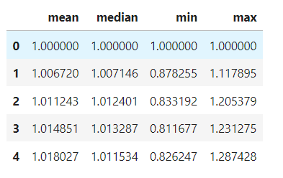
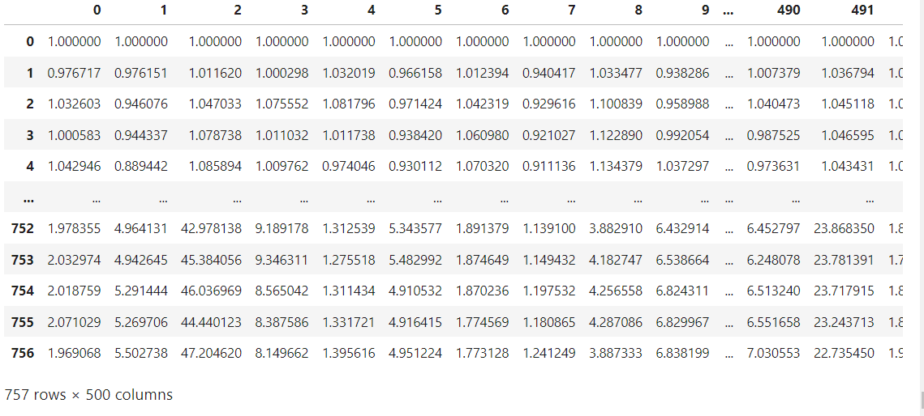
TESLA

Slide 16
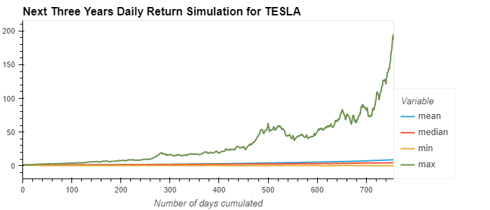
Create line graph for Tesla 3 years daily return simulation

Slide 17
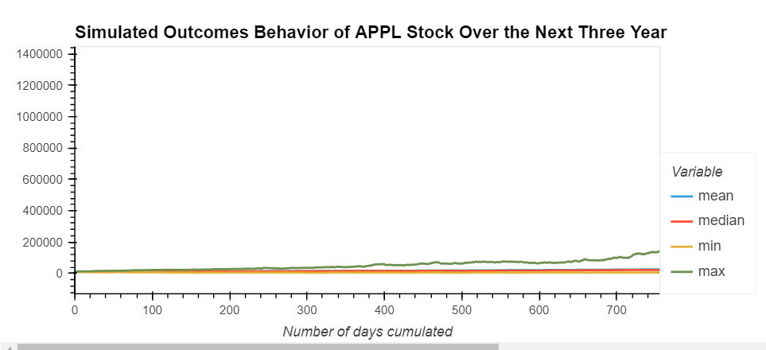
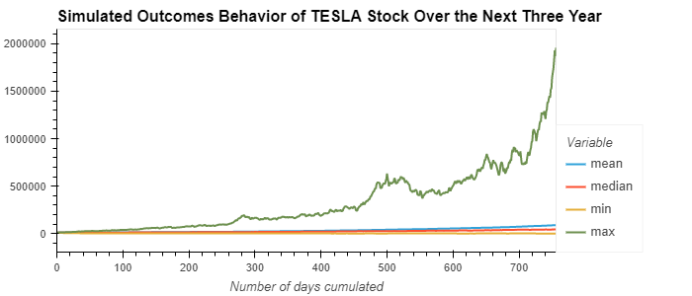
Compare Tesla and Apple 3 years outcomes performace

Slide 18
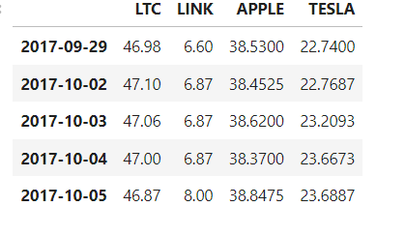
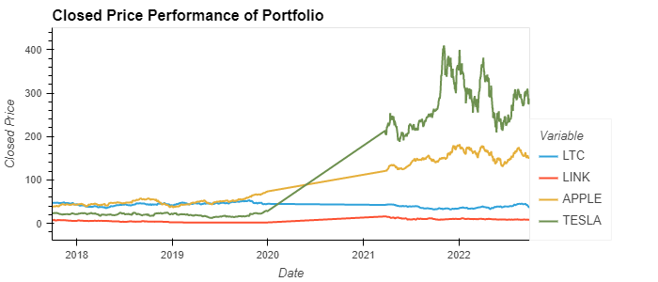
Combined Portfolio for cryptocurrency and stock

Slide 19
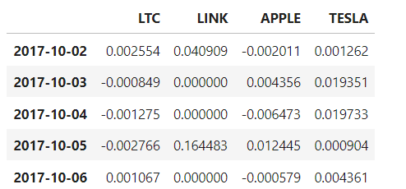
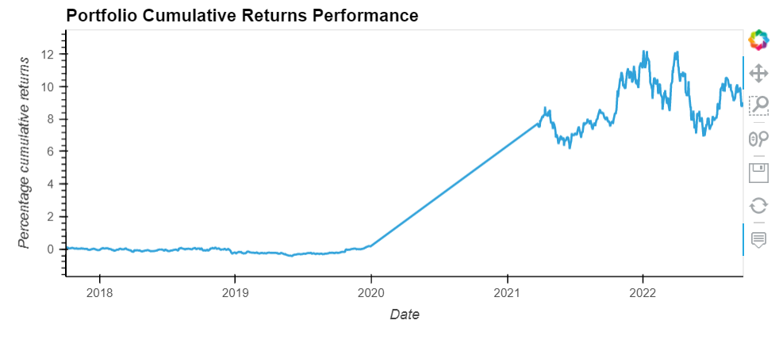
Daily returns of portfolio

Slide 20
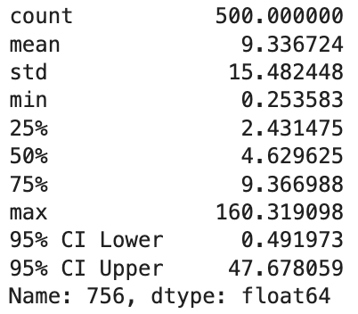
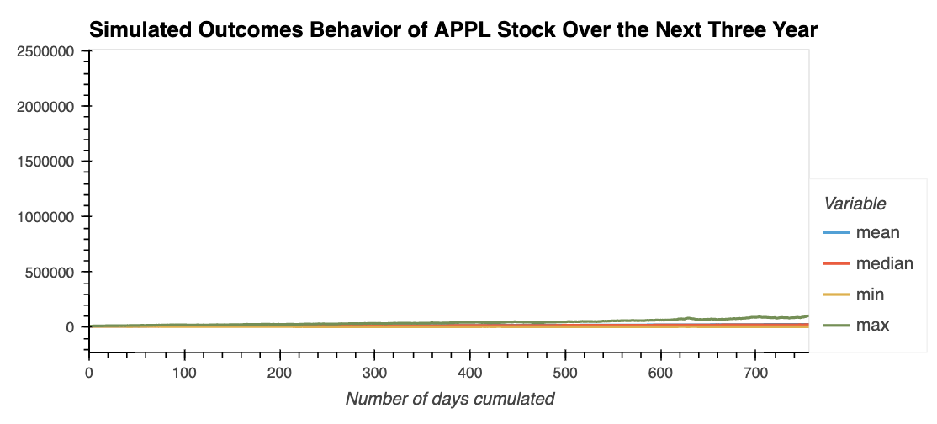
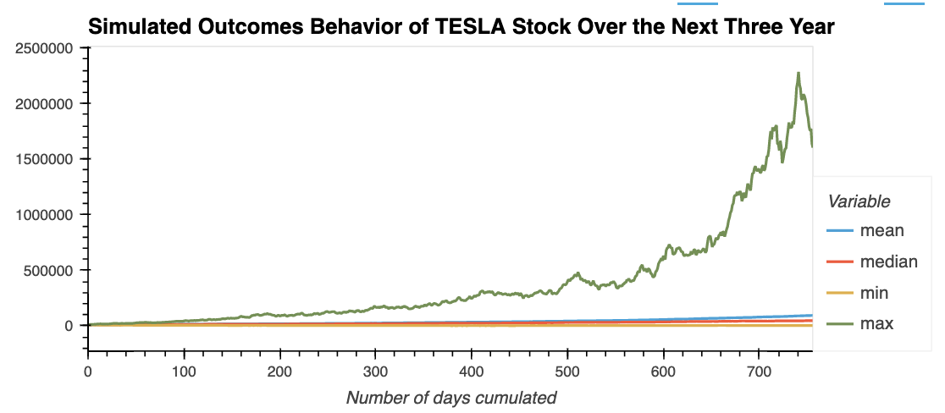
Summarize statistics from the Monte Carlo Simulation results

Slide 21
Summarize statistics from the Monte Carlo Simulation results
There is a 95% chance that an initial investment of $10,000 in APPLE stock over the next year will end within in the range of $4919.73 and $476780.59.

Slide 22
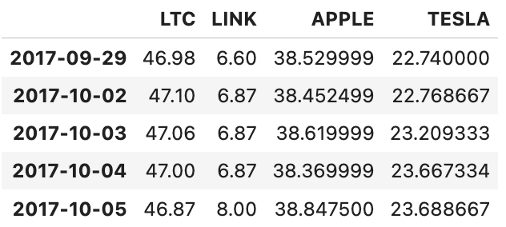
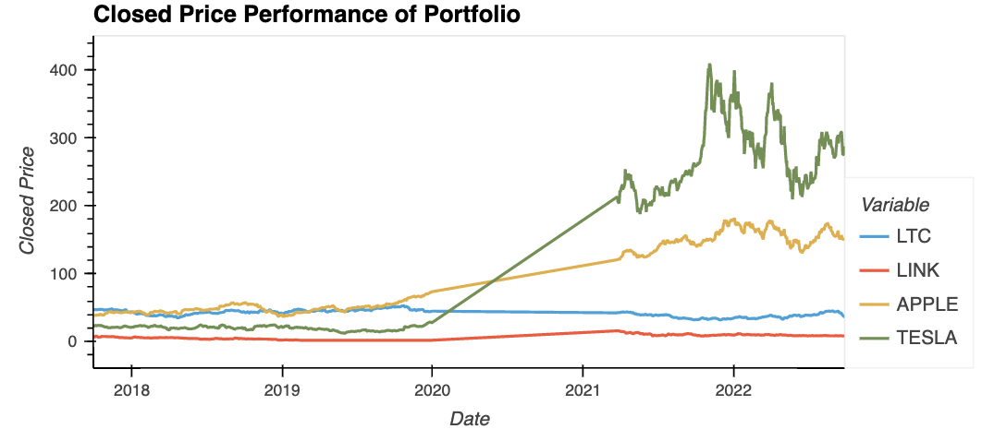
Combined Portfolio for cryptocurrency and stock

Slide 23
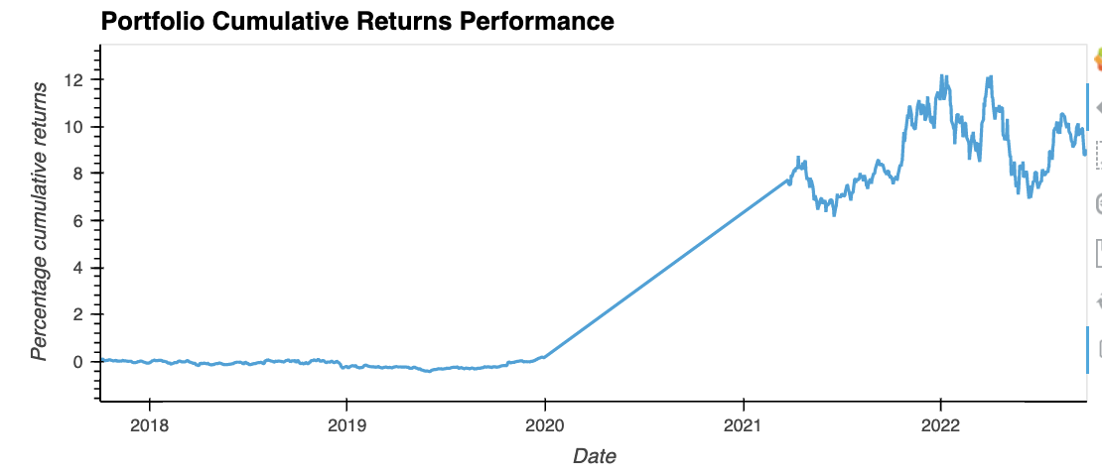
Investment outcomes for our portfolio
In general, our portfolio is making profit. However, cumulative returns after 2021 has significant fluctuation.

Slide 24
Lessons Learned
Cummulative performance of an investment is total movement of total percentage of movement in the prices over a specified period
Litecoin and chainlink have not moved much from 2017 overs the next 5 years
Tesla increased over 200% from 2017

